Slide 1


INSTAGRAM USER ANALYTICS:UNVEILING INSIGHTS WITH SQL FUNDAMENTALS
Surani Smit

Slide 2

AGENDA
Project Description
Approach
Tech-Stack Used
Data-set
Insights
Result
120+

Slide 3

Project Description
This project revolves around user analytics for Instagram and derives trends like the number of oldest users, the number of inactive users, the user with the most likes, hashtag research, launching an ad campaign, user engagement, and details about bots and fake accounts, etc.
These statistics are important for a company to analyze for better user engagement and are also useful for investors, so it becomes a crucial task for a data analyst.
120+

Slide 4
Approach
Data Analysis Steps:
Data Extraction: SQL queries to retrieve necessary information.
Data Transformation: Using CTEs (Common Table Expressions) and JOINs.
Data Analysis: Applying aggregation functions and window functions.
Insight Derivation: Interpreting results to answer specific business questions.
The approach towards this project is to use SQL queries to analyze the database provided.
120+

Slide 5
Tech-Stack Used
MySQL Workbench: for this project we have use MySQL workbanch 8.0.36 CE ,it is choosen for it’s user-friendly interface and powerful SQL capabilities.
Noteped : Fro saving Quary
Microsoft PowerPoint : To create PPT
120+
Data-set :
https://docs.google.com/document/d/1-WhNRX1iYJIz7e5l28DMPWgsPklpE_w6/edit

Slide 6
Insights
A) Marketing Analysis:
Loyal User Reward: Identified the oldest users.
Inactive User Engagement: Found users with no photos.
Contest Winner: Determined the user with the most photo likes.
Popular Hashtags: Listed the top five hashtags.
Ad Campaign Timing: Identified the best day for ad launches.
B)Investor Metrics:
User Engagement: Calculate the average number of posts per user and total number of photos on Instagram divided by the total number of users.
Bots & Fake Accounts: Identify users (potential bots) who have liked every single photo on the site,
120+

Slide 7
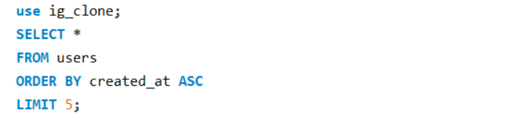
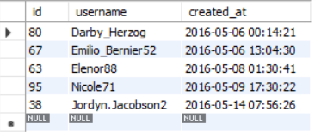
SQL Tasks :
A) Marketing Analysis:
1 ) Loyal User Reward: five oldest users on Instagram
QUARY:
120+
OUTPUT:

Slide 8
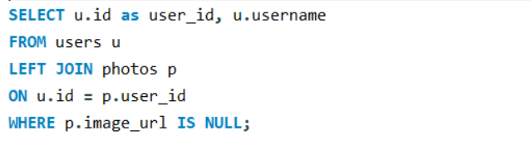
2. Inactive User Engagement: users who have never posted a single photo on Instagram.
QUARY:
120+

Slide 9
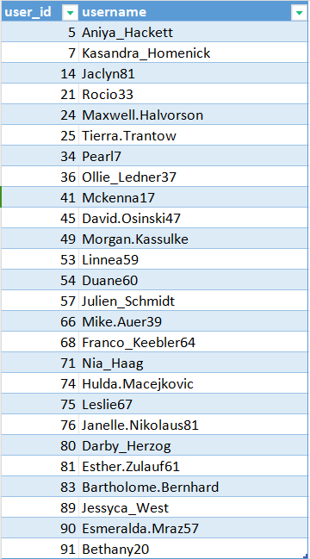
OUTPUT:
120+
These are the users who have never posted a single photo on Plateform.

Slide 10
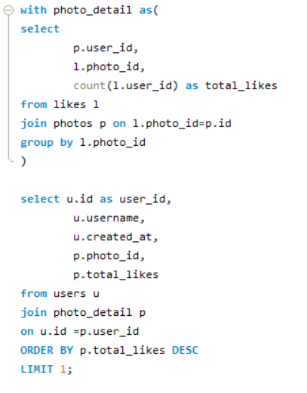


3. Contest Winner Declaration: Most popular photo and user
QUARY:
OUTPUT:
The contest winner with the height like in a single photo is Zack_kemmer93.
120+

Slide 11
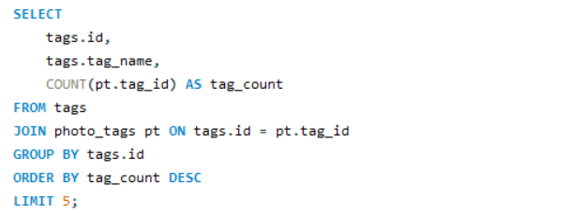
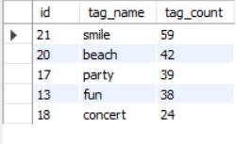
4. Hashtag Research: top five most commonly used hashtags on the platform.
QUARY:
120+
OUTPUT:

Slide 12
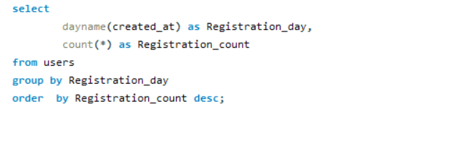
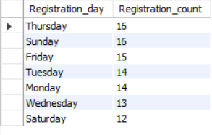
5. Ad Campaign Launch: the day of the week when most users register on Instagram.
QUARY:
120+
OUTPUT:

Slide 13
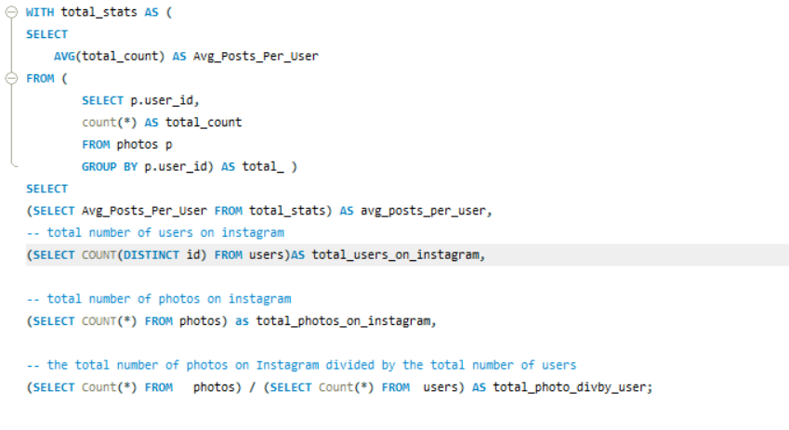
B) Investor Metrics:
1) User Engagement:Calculate the average number of posts per user on Instagram. Also, provide the total number of photos on Instagram divided by the total number of users.
QUARY:
120+

Slide 14

OUTPUT:
120+

Slide 15
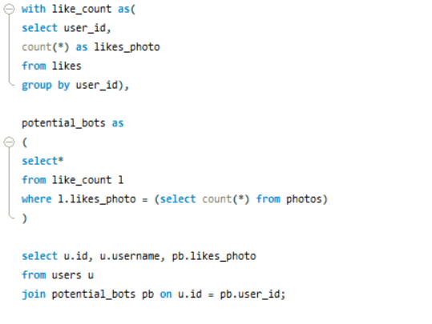
2) Bots & Fake Accounts: Identify users (potential bots) who have liked every single photo
QUARY:
120+

Slide 16
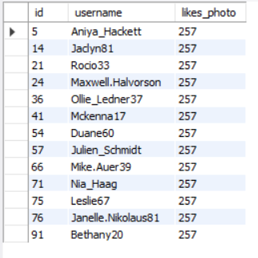
OUTPUT:
Here is the information about users (potential bots) who like every post.
120+

Slide 17
Result:
The Instagram user analytics project provided insights on marketing, User engagements, Bots and Fake accounts. Now these insight can be used by Instagram product team to launch new campaigns, track users engagement and improve user experience.
Here are the insights I found in these project
Top 5 Oldest users of Instagram
Users who never posted photos on Instagram
Most liked photo on Instagram
Top 5 most commonly used has-tags on Instagram
day of the week when most users register on Instagram.
Total number of users on Instagram
Total number of photos on Instagram
Average number of photos per user
Bots and fake accounts on Instagram
Surani Smit

